Slide 1
Hyper-V Live Migration
By Quinn Aschoff and Brady Esplin

Slide 2
Project Scope
Explain Hyper-V Live Migration in an easy to understand manner
Show tutorial of how to set up a Hyper-V Live Migration
Demonstrate a working model of Hyper-V Live Migration
Notes:
NOTE: Quinn, since the migration takes a while on our super slow catbox do we want to start the demonstration right here and then go through the presentation and afterwards show the transferred VM?

Slide 3
Project Description: What is Hyper-V Live Migration?
Hyper-V Live Migration is a service that allows you to take a running virtual machine and transfer it from one host to another with no perceivable downtime! The advantage live migration is that a virtual machine is not tied to one host, it can be moved at will, as needed.

Slide 4
Tutorial: Hyper-V Live Migration
First Steps: Fulfill these requirements-
Have a user account with permissions to complete the various steps.
The Hyper-V Role must be installed on two servers.
Servers must be in the same domain, or have trusts with each other.
Have Hyper-V Management Tools installed.
Notes:
First Steps: Fulfill these requirements-
Have a user account with permissions to complete the various steps. (The account can be in the local Hyper-V administrators group or the Administrators group on both source and destination servers.)
The Hyper-V Role must be installed on two servers.
Servers must be in the same domain, or have trusts with each other.
Have Hyper-V Management Tools installed.

Slide 5
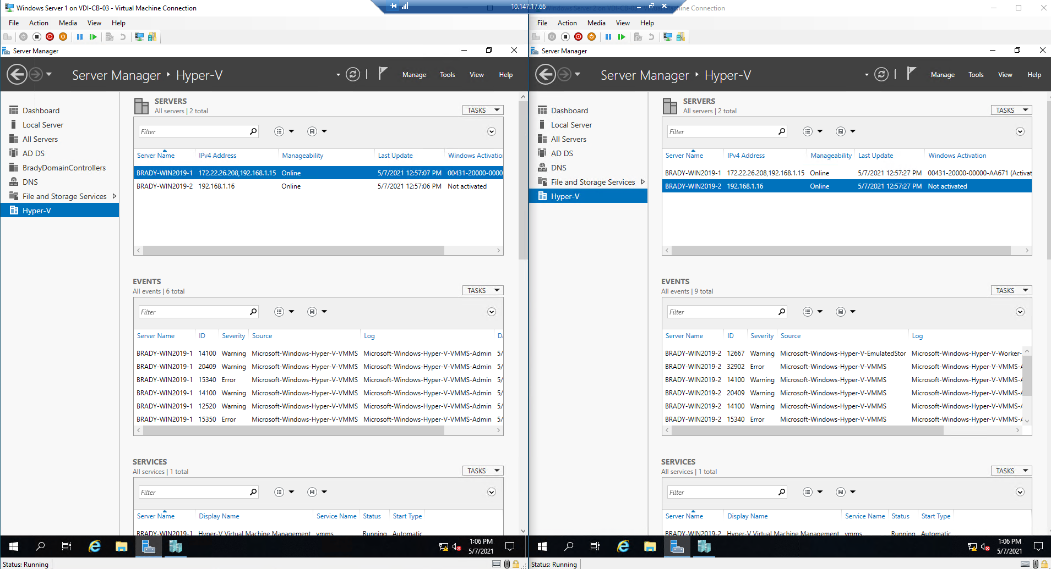
Tutorial: Hyper-V Live Migration
Notes:
On this screen is a screenshot showing the Hyper-V Role has been installed on both servers and the Hyper-V Maagement Tools are installed. In these types of screenshots, just to keep you aware of which server is which, we have kept BRADY-WIN2019-1 on the left side of the screen and BRADY-WIN2019-2 on the right side of your screen.

Slide 6
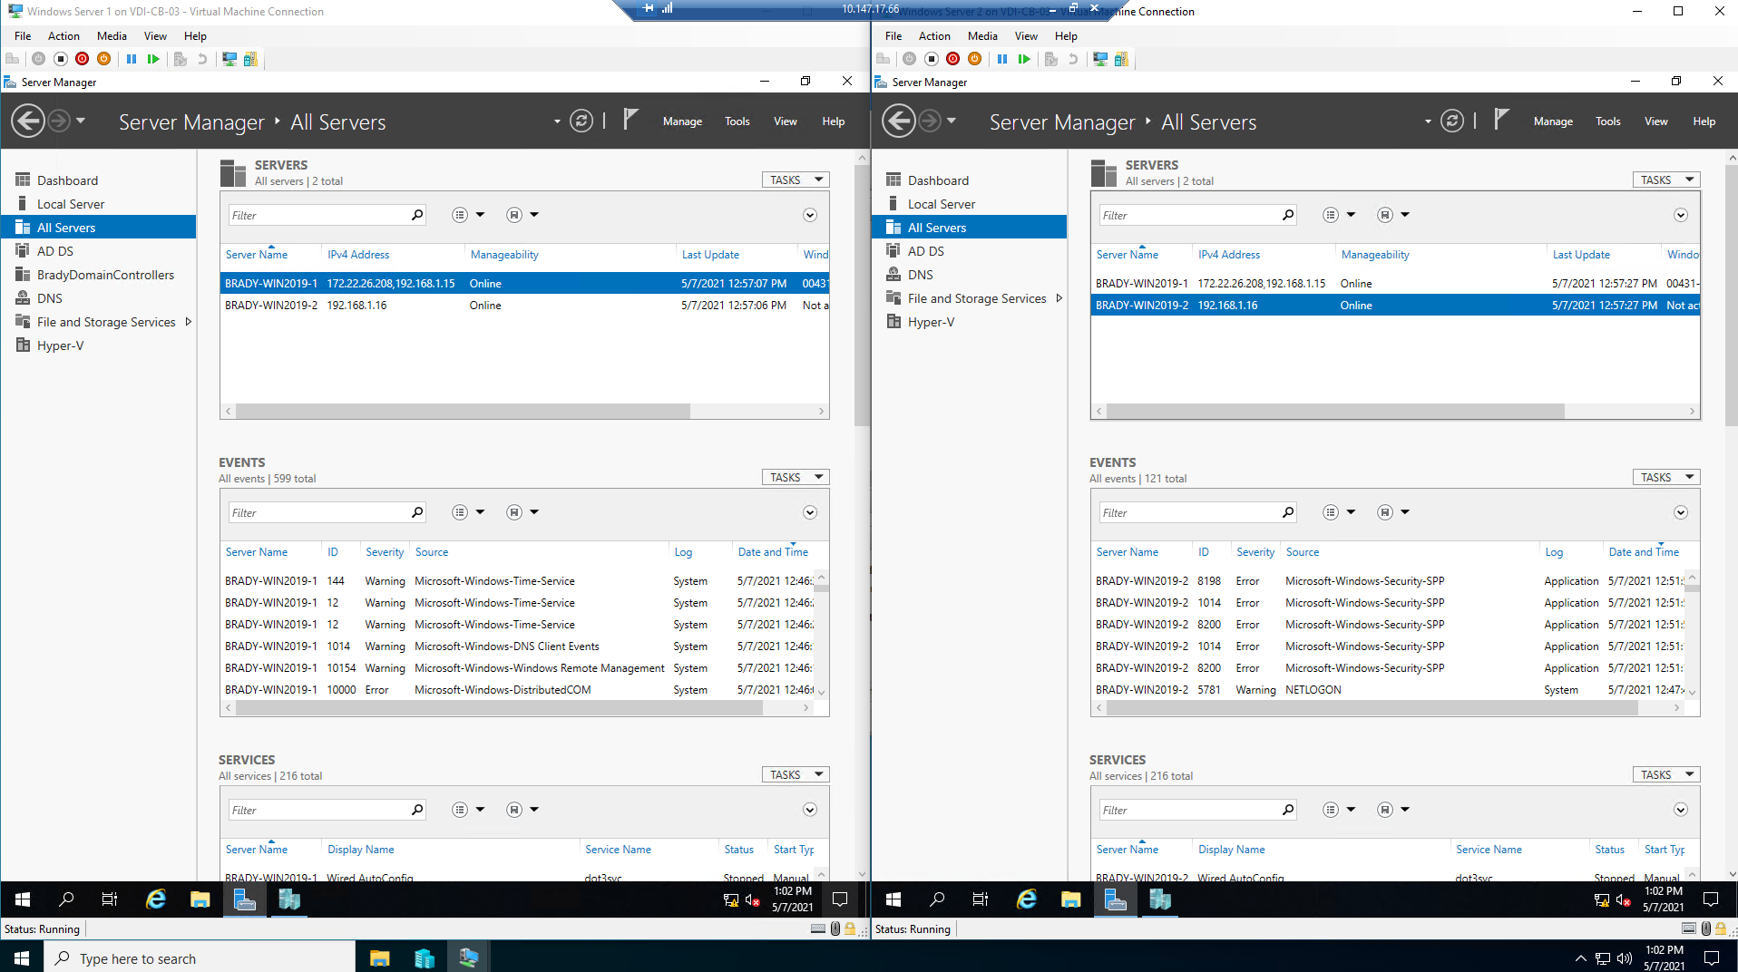
Tutorial: Hyper-V Live Migration
Notes:
On this screen is a screenshot showing that both servers are on the same domain.

Slide 7
Tutorial: Hyper-V Live Migration
Next Steps:
Decide if you will use CredSSP or Kerberos for authentication.
Decide if you will configure performance options.
Understand what networks you will use for the Live Migration.
Notes:
Decide if you will use CredSSP or Kerberos for authentication. Using Kerberos will allow you to avoid signing into the server but requires you to set up what is called constrained delegation which we won’t get into because we didn’t use it. If you are interested in what constrained delegation is I suggest that you look up the Microsoft Docs for Live Migration which will provide a link to a in-depth tutorial. Using CredSSP will mean that you must sign into the source server through a local console session, remote desktop session, or remote Windows PowerShell session. If you do not sign into the source server the transfer will fail.
Decide if you will configure performance options. Changing performance options can reduce network and CPU usage and make the Live Migration go faster.
Understand what networks you will use for the Live Migration. You may use any available networks for the Live Migration or you may isolate the Migration onto a trusted, private network. (as Live Migration traffic is unencrypted when it is sent over the network)

Slide 8
Tutorial: Hyper-V Live Migration
Last Steps:
Connect the Servers in the Hyper-V Manager
Make sure the Hyper-V settings on both servers allow for Live Migrations
Right-click the VM you want to move, select the “Move” option, and follow the wizard!

Slide 9
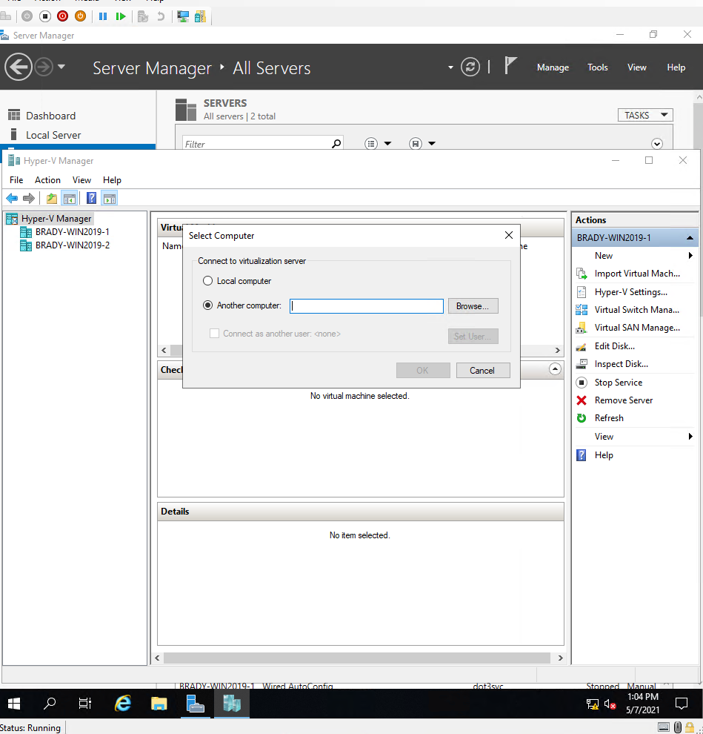
Tutorial: Hyper-V Live Migration
Notes:
This is a screenshot showing the resulting screen when you right-click on the Hyper-V Manager area above the Server names. In this screen you can hit the Browse button to go into a sort of advanced search for your computer that you would like to connect to or you can simply type the name into the text entry box. As you can see in upper-left corner of the Hyper-V Manager in the screenshot, we have already connected our Server 2 to the Hyper-V Manager on our Server 1.

Slide 10
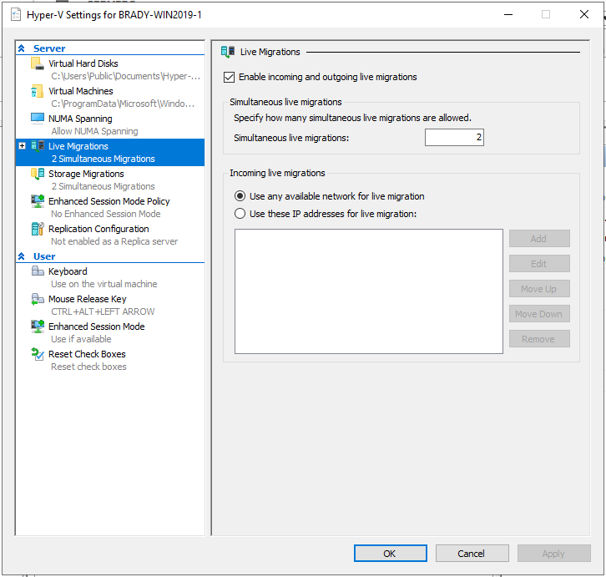
Tutorial: Hyper-V Live Migration
Notes:
This is a screenshot showing the what your Hyper-V settings should look like when you are attempting to do a live Migration. If the Enable incoming and outgoing live migrations box is not checked the wizard will simply not run and alert you that you must change these settings. Below that option is where you would select if you would like to you any network for the live migration or specify certain IP addresses.

Slide 11
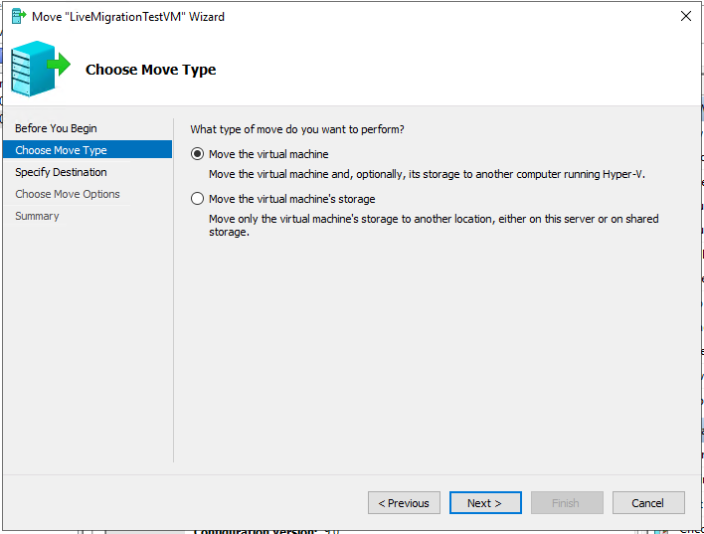
Tutorial: Hyper-V Live Migration
Notes:
This is the second screen of the wizard that appears after you right-click on the VM that you want to move and select the “Move” option. The first screen that appears is simply a warning screen, presenting cautions and warnings that users should be aware of before they start their live migration. These on-screen options would be helpful if, for example, you already had an identical virtual machine set up on another server and simply wanted to move the files and folders to the new location to save time and CPU and network resources. Or you can do as we are doing and simply move the entire Virtual Machine.

Slide 12
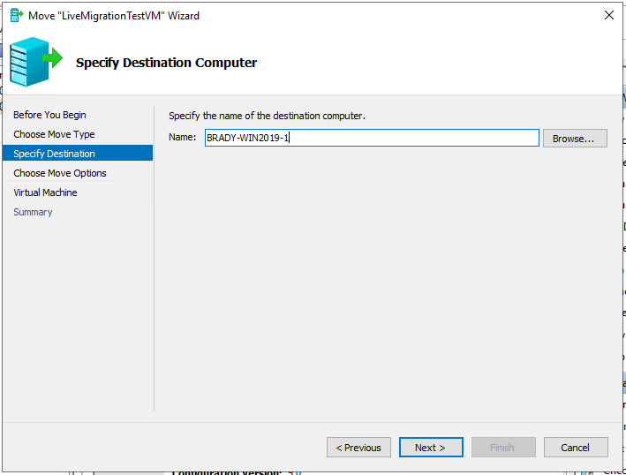
Tutorial: Hyper-V Live Migration
Notes:
This screenshot is showing the next screen in the wizard in which we have already entered the name of the computer that we will transfer our VM to. Again, you can use the Browse button to go into a more advanced screen to locate the name of your destination computer or you can simply type it into the text-entry box.

Slide 13
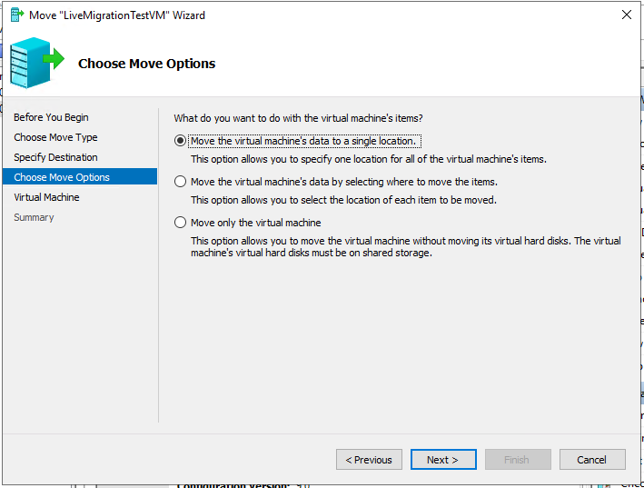
Tutorial: Hyper-V Live Migration
Notes:
This is the fourth screen of the wizard, in which you will decide what you want to actually move. You can specify exactly where you want to move each piece of the VM’s data with the second option, or you can move only the virtual machine if you have the files and folders already set up in shared storage. Or you can select the first option, like we have here, that will move the virtual machine and the files and folders all to one location on the target machine.

Slide 14
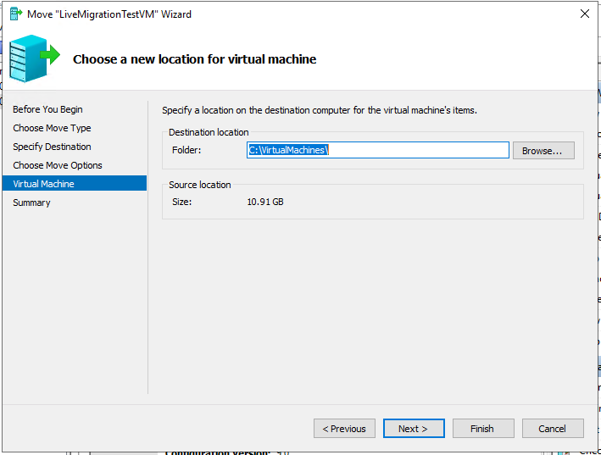
Tutorial: Hyper-V Live Migration
Notes:
This screenshot shows the location on the target computer that you will move the virtual machine and the accompanying files and folders to. In this case we made a new folder on C drive called VirtualMachines to store the VM.

Slide 15
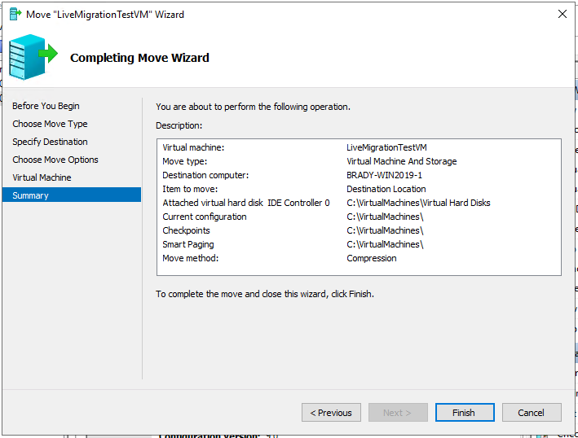
Tutorial: Hyper-V Live Migration
Notes:
This screenshot is the last screen of the wizard, before you actually start the transfer. It gives you a final chance to confirm all of your choices and check over all of your decisions up until this point. At this point when you are happy with the decisions that you have made, you hit the Finish button and sit back and wait.

Slide 16
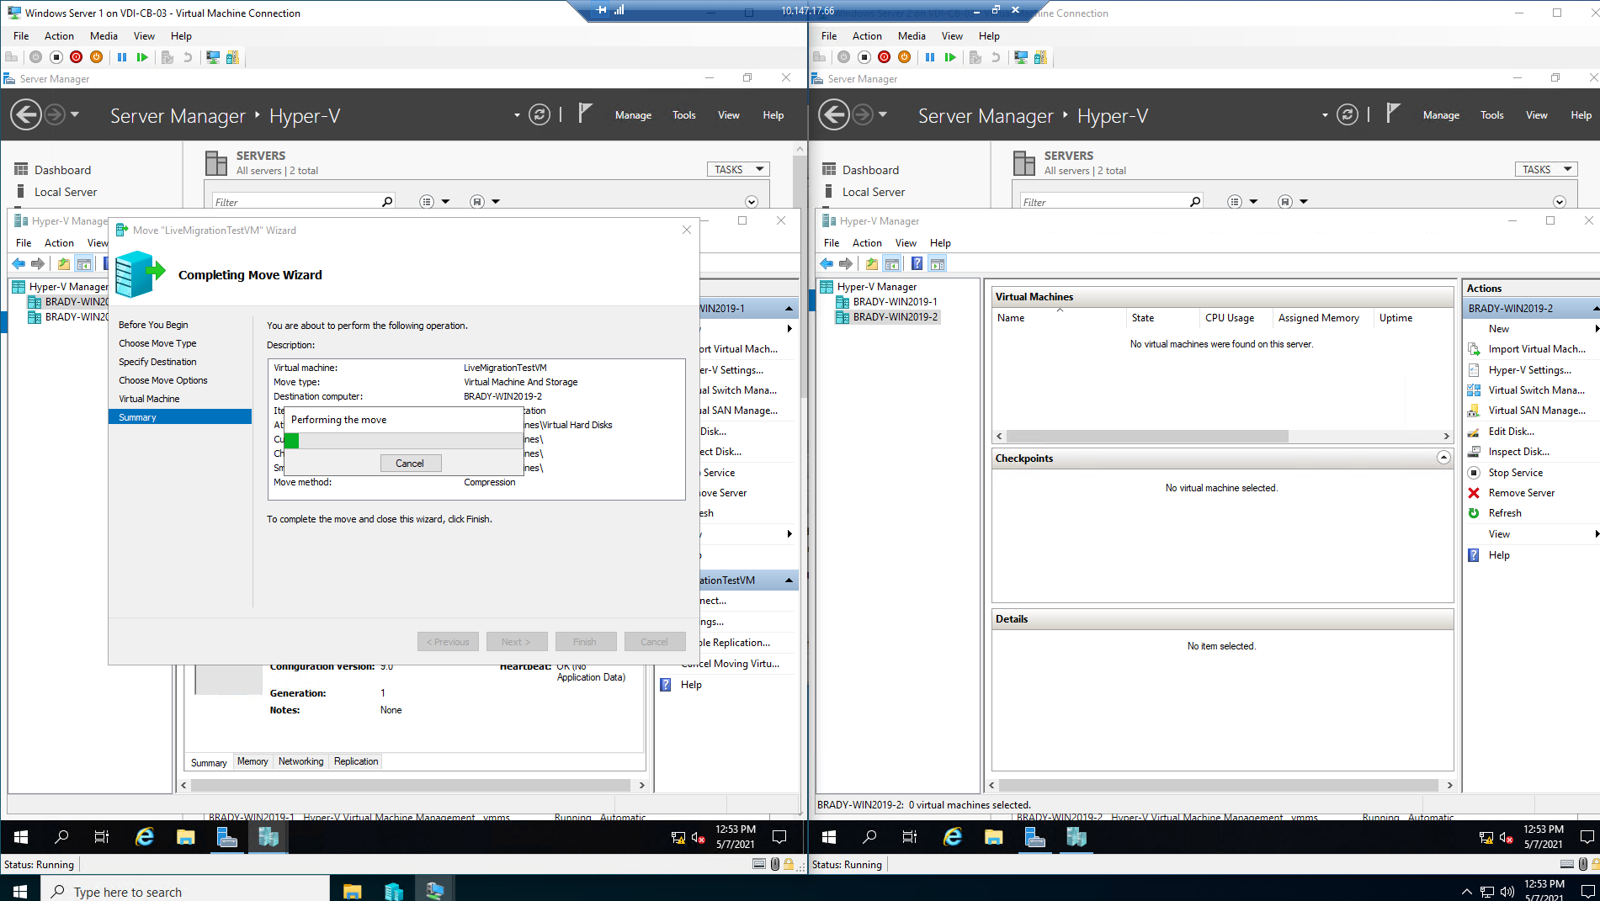
Tutorial: Hyper-V Live Migration
Notes:
This screenshot shows the screen that you will be staring at for a long while the Catbox is struggling to move a triple-nested VM from one Virtual Server to another.

Slide 17
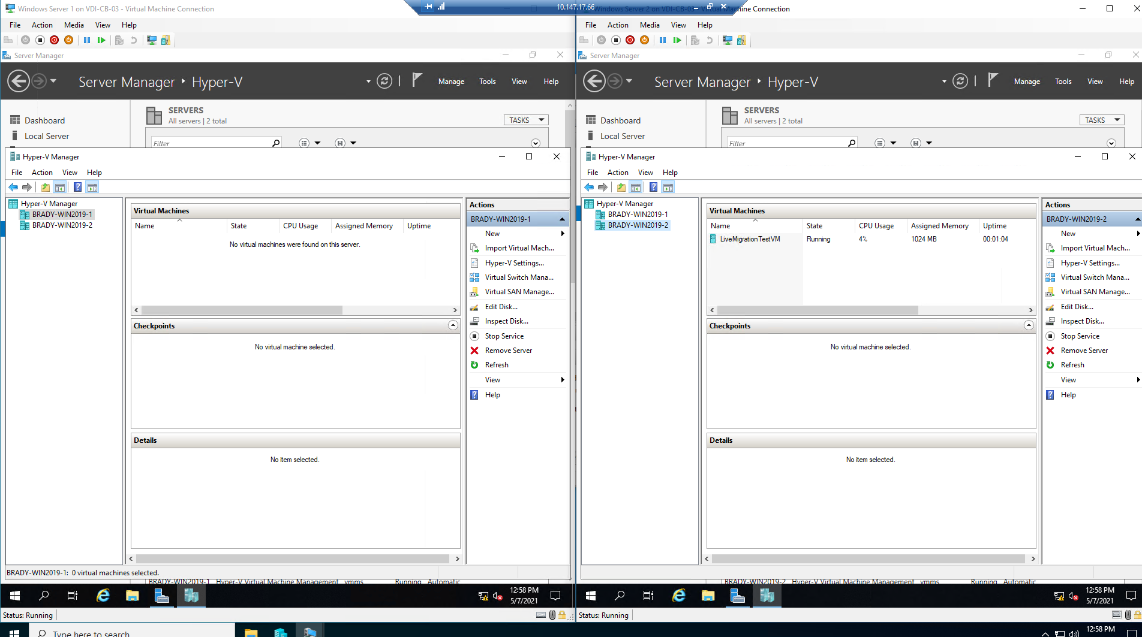
Tutorial: Hyper-V Live Migration
Notes:
And this screenshot shows a successful Live Migration of a running Virtual Machine that transferred from BRADY-WIN2019-1 to BRADY-WIN2019-2 with no downtime!

Slide 18
Roadblocks, Speed Bumps, and Findings
Roadblock 1: Using Catboxes hit a snag with enabling Hyper-V role on servers. Message from Sisi states: Cannot enable virtualization on Catbox, alternate methods needed.
Roadblock 2: AWS does not support nested virtualization on the free ec2 instances, so we cannot use AWS for this project.
Roadblock 3: We are unable to use nested virtualization on a desktop for some reason. So we cannot use Hyper-V or Oracle VM Virtualbox on a home desktop to run Hyper-V enabled servers for this project.
Roadblock 4: We are running into a problem in Azure, as Azure seems to have a peculiar DNS setup that messes up any connections in between VMs running on Hyper-V on an Azure VM.
Notes:
We ran into several Roadblocks or speed bumps on this project which we will go over in the retrospective on the next slide.

Slide 19
Retrospective
What worked?
Catbox
What did not work?
AWS and Azure
What could we have done differently?
Nothing
Notes:
What worked: Eventually the Catbox was a viable option. The Live Migration itself seemed simple in comparison to the struggle that we had just setting up the environment that we would use for this project.
What did not work: AWS and Azure. We are sure that AWS and Azure are both viable options to set up an environment that you can test Live Migration in but the free instances that AWS allows you to use do not support nested virtualization and in our Azure environment we struggled for at least four or five solid hours with what we believe to be a DNS error caused by the way that you have to set things up in an Azure environment.
What could we have done differently: Based on the knowledge that we had at the time, we wouldn’t have done any of this project any differently. But if we had known that the Catboxes could be forced to support nested virtualization then we would have had the hardest part of the project completed after our first meeting back in Week 3. We wanted to use the Catbox environment primarily because it was already set up and would be perfect for testing a Live Migration.
When that didn’t work, we tested AWS. We found AWS to be even less user-friendly than Azure, with the software being free but a pay-by-the-hour charge for infrastructure. After finding out that AWS does not support nested virtualization on the free EC2 VMs, we decided to abandon AWS in favor of Azure as Quinn still had some credit remaining from CS240A and Brady still had all of his credit remaining.
We set up two Windows 2019 servers in an environment on Azure, and were able to get the Hyper-V Role installed on both servers but we could not join the second server to the domain of the first server. After a few hours we gave up, thinking that we would need to use a different network topology due to the constraints of the Azure environment.
The next attempt failed after we got the servers built and installed but attempted to bridge over the network adapter which caused us to permanently disconnect from the servers and we were unable to reconnect.
For the Final Azure attempt we set up an Azure Windows 2019 Server and installed the Hyper-V Role on it and then added two VMs on that machine, both running different copies of Windows Server 2019 and then installed the Hyper-V Role on both of those machines. Everything was running relatively smoothly up until that point, so we started to make the VM that we would transfer from one server to another. At this point we attempted to use the Hyper-V Manager to connect from one server to another and no matter what we did, we kept getting error messages saying that “the server was not operational”. All of the wiki’s, blogs, and articles that we were able to find detailing this type of error suggested that the error was a DNS issue caused by the way that the Azure environment was set up. It was at this point that we gave up for the day.
We were in contact with Will Shields as their group is doing the same project and he communicated to us that he had found a workaround that would allow us to use the Catboxes after all. We went into the Catboxes using a Windows PowerShell commandlet with Administrator rights and then nested virtualization worked perfectly, albeit slowly, on the Catboxes.

Slide 20

Questions and Answers

